Slide 1
Can spatial patterns mitigate the urban heat island effect? Evidence from German metropolitan regions
Wenzheng Li, Ph.D. Candidate
Stephan Schmidt, Associate Professor
City and regional planning, Cornell University

Slide 2
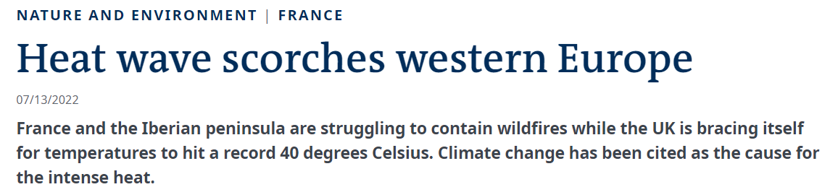
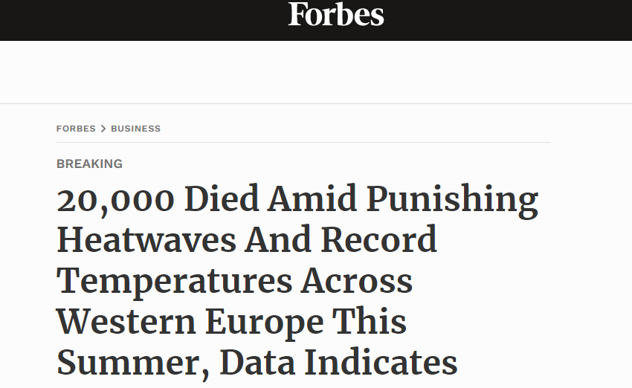
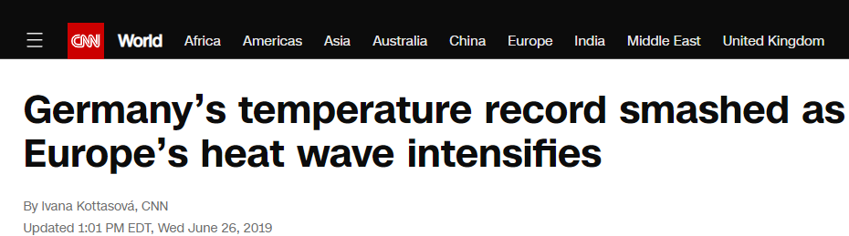
Introduction
UHI effect: the thermal anomaly of higher temperature in urban areas compared with less densely populated rural areas.
Multiple dimensions: urban vs. rural; diurnal vs. nocturnal period; warm vs. cold seasons
Adverse impacts: raising energy consumption; air pollution; serious risks to human health (Debbage and Shepherd, 2015, Stone, 2012; Zhou and Shepherd, 2010).
Spatial planning policy to address increasing challenge caused by severe heatwaves in Western Europe
Notes:
increases risks of heat-related mortality by exacerbating the intensity of heatwaves
The increasing number of heat deaths in Western Europe highlights the urgency of implementing spatial planning policies to mitigate heat intensity and reduce heat-related costs.

Slide 3
The effects of urban spatial patterns on the UHI effect
Traditional wisdom:
Denser and compact urban development -> greater UHI intensities.
mechanisms contributing to heat accumulation are amplified in denser urban areas (Couts et al., 2007; Debbage and Shepherd, 2015).
Sprawling, low-density and fragmented development -> exacerbate UHI intensities.
impervious surface coverage, energy consumption (Ewing and Rong, 2008; Shreevastava et al., 2019).
A dilemma in regional and spatial planning policy:
Is high-density and compact growth a viable mitigation strategy or will it make cities less livable?

Slide 4
Polycentric spatial development (polycentrism)
Reconciles this dilemma (dichotomy)?
Multiple centers, balanced structure, network of interconnections
integrate the benefits of both compact and dispersed development (Meijers and Burger, 2010)
“Decentralization”: less concentrated around a single center
“Compactness”: decentralized activities re-agglomerate outside urban core
Lower density in urban cores; high-density design; reduced energy consumption
Density
Density
Density
CBD
CBD
Sub-CBD
CBD
Sub-CBD
Distance to CBD
Distance to CBD
Distance to CBD
Compact and monocentric development
Sprawling and decentralized development
Polycentric development

Slide 5
Research objectives:
By examining the UHI intensities of 50 metropolitan regions in Germany with various landscape/urban spatial structure metrics, this study aims to:
evaluate the degree to which traditional urban spatial patterns, including measures of land-use composition, fragmentation, and shape complexity, influence the UHI effect.
investigate the capacity of a polycentric spatial pattern, characterized by features of disaggregation and compactness, to mitigate urban heat.

Slide 6
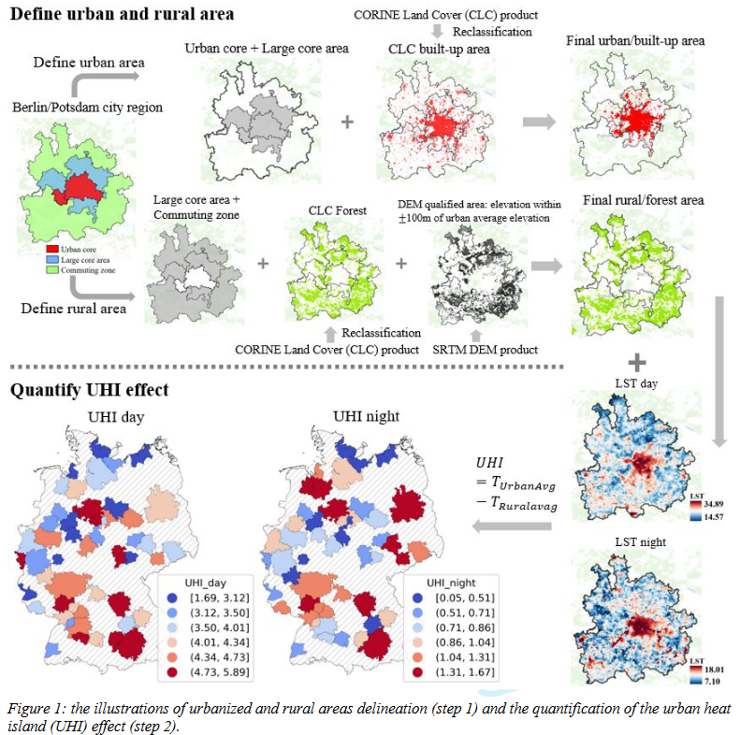
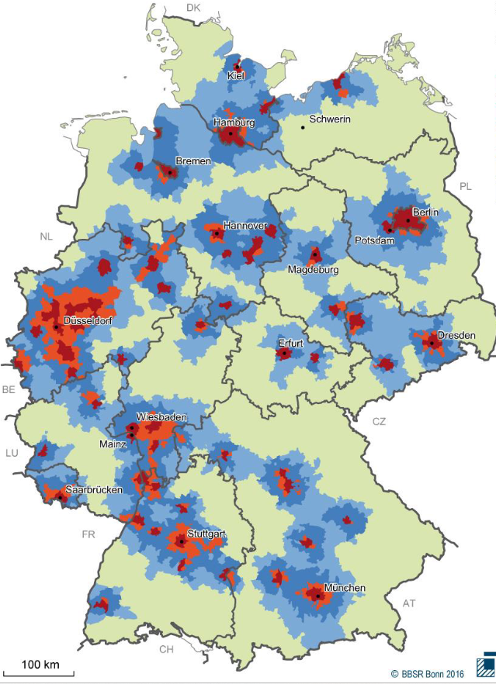
German Regions
Berlin/Potsdam
Area: 50 functional city-regions
Data:
Land surface temperature (LST)
in June, July, August
MODIS Aqua satellite 1km.
Collect 1:30PM and 1:30AM
CORINE Land Cover
SRTM DEM

Slide 7
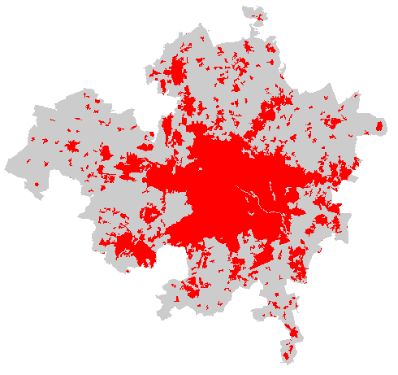
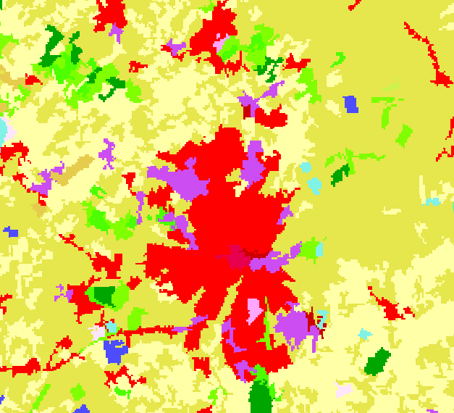
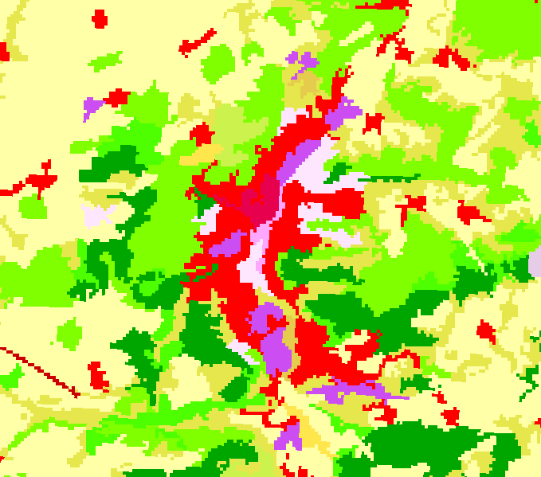
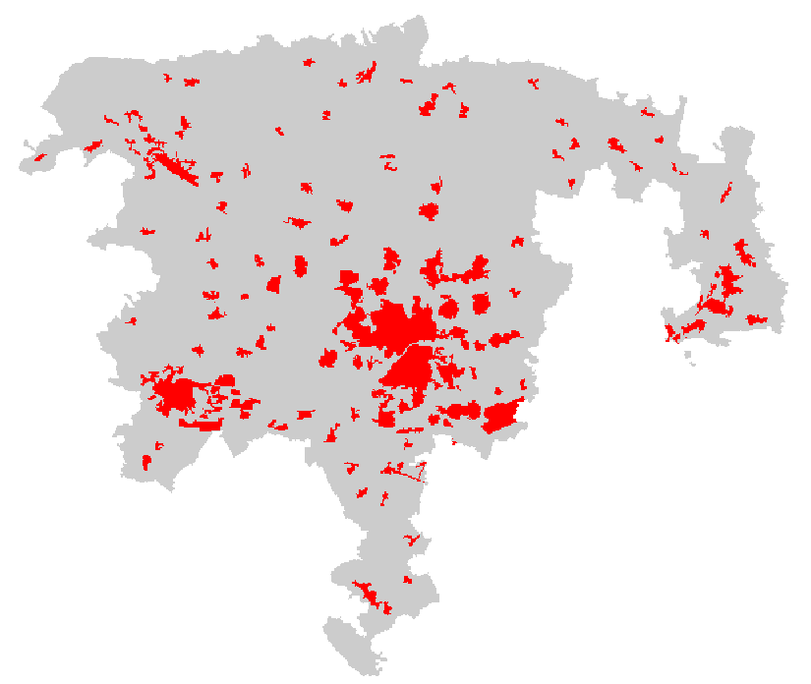
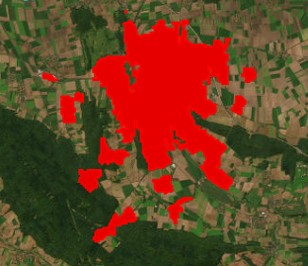
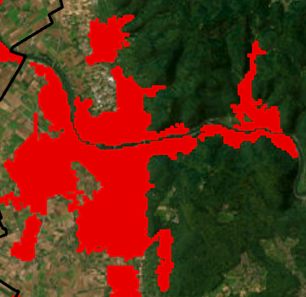
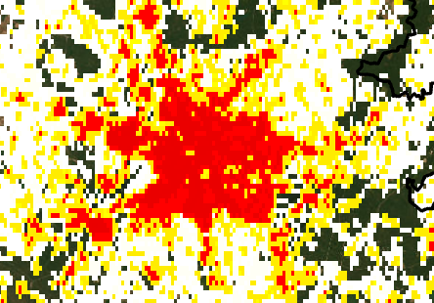
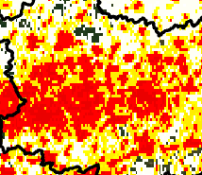
Spatial metrics for urban spatial patterns
Fragmentation
Mixed land use
Berlin/Potsdam
Ingolstadt
Oldenburg
Jena
Patch density (PD): 0.228
Percentage of like
adjacencies (PLADJ): 91.117
Patch density (PD): 0.872
Percentage of like
adjacencies (PLADJ): 83.86
Contagion index: 38.22
Contagion index: 62.99
Shape complexity:
Polycentricity index:
Hildesheim
Heidelberg
Berlin/Potsdam
Essen/Bochum/Dortmund/Hagen
Area-weighted mean shape index (AWMSI): 1.67
Area-weighted mean shape index (AWMSI): 2.18
Polycentricity index: 0.375
Polycentricity index: 0.892

Slide 8
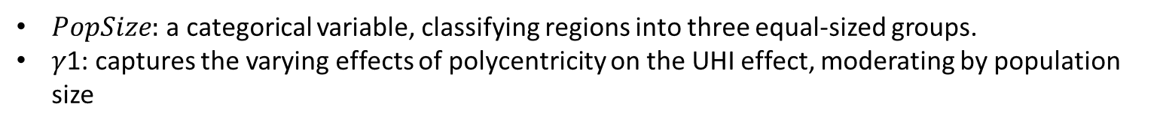
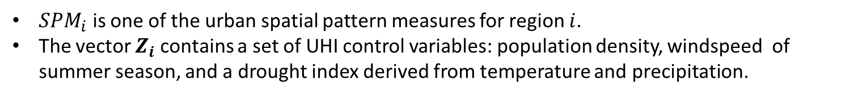
Regression analysis (cross-sectional analysis)
$SPM_{i}$ is one of the urban spatial pattern measures for region $i$.
The vector $Z_{i}$contains a set of UHI control variables: population density, windspeed of summer season, and a drought index derived from temperature and precipitation.
Assumption: large regions reap greater benefits from polycentrism than smaller regions
$PopSize:$a categorical variable, classifying regions into three equal-sized groups.
$\text{γ}\text{1: }$captures the varying effects of polycentricity on the UHI effect, moderating by population size
Data sources: Population: INKAR; windspeed (JJA): ERA5 monthly averaged data; Drought index in summer: Deutscher Wetterdienst
Notes:
We propose that the influence of polycentric development on the UHI effect may vary contingent upon the size of regions, with large regions potentially reaping greater benefits. This assumes that a polycentric configuration can effectively redistribute concentrated activities among multiple urban cores of large-sized regions, thereby mitigating the concentration and accumulation of human heat sources. T

Slide 9
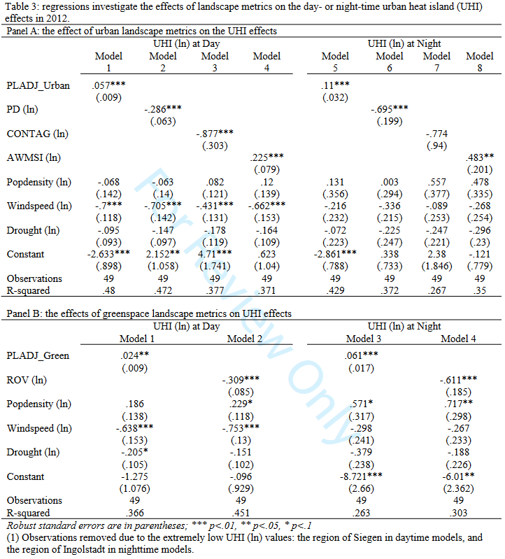
The influence of traditional landscape metrics on the UHI effect
For urban patches
PLADJ_urban: ↑ aggregation and contiguity → ↑ UHI

Slide 10
The influence of traditional landscape metrics on the UHI effect
For urban patches
PLADJ_urban: ↑ aggregation and contiguity → ↑ UHI
PD: ↑ fragmentation and patchiness → ↓UHI

Slide 11
The influence of traditional landscape metrics on the UHI effect
For urban patches
PLADJ_urban: ↑ aggregation and contiguity → ↑ UHI
PD: ↑ fragmentation and patchiness → ↓UHI
CONTAG: ↑ mixed landcover types → ↓UHI

Slide 12
The influence of traditional landscape metrics on the UHI effect
For urban patches
PLADJ_urban: ↑ aggregation and contiguity → ↑ UHI
PD: ↑ fragmentation and patchiness → ↓UHI
CONTAG: ↑ mixed landcover types → ↓UHI
AWMSI: ↑ irregularity in the shape → ↑ UHI

Slide 13
The influence of traditional landscape metrics on the UHI effect
For urban patches
PLADJ_urban: ↑ aggregation and contiguity → ↑ UHI
PD: ↑ fragmentation and patchiness → ↓UHI
CONTAG: ↑ mixed landcover types → ↓UHI
AWMSI: ↑ irregularity in the shape → ↑ UHI
For green spaces
PLADJ_green: ↑ aggregation and contiguity → ↑ UHI

Slide 14
The influence of traditional landscape metrics on the UHI effect
For urban patches
PLADJ_urban: ↑ aggregation and contiguity → ↑ UHI
PD: ↑ fragmentation and patchiness → ↓UHI
CONTAG: ↑ mixed landcover types → ↓UHI
AWMSI: ↑ irregularity in the shape → ↑ UHI
For green spaces
PLADJ_green: ↑ aggregation and contiguity → ↑ UHI
ROV: ↑ vegetated coverage → ↓UHI

Slide 15
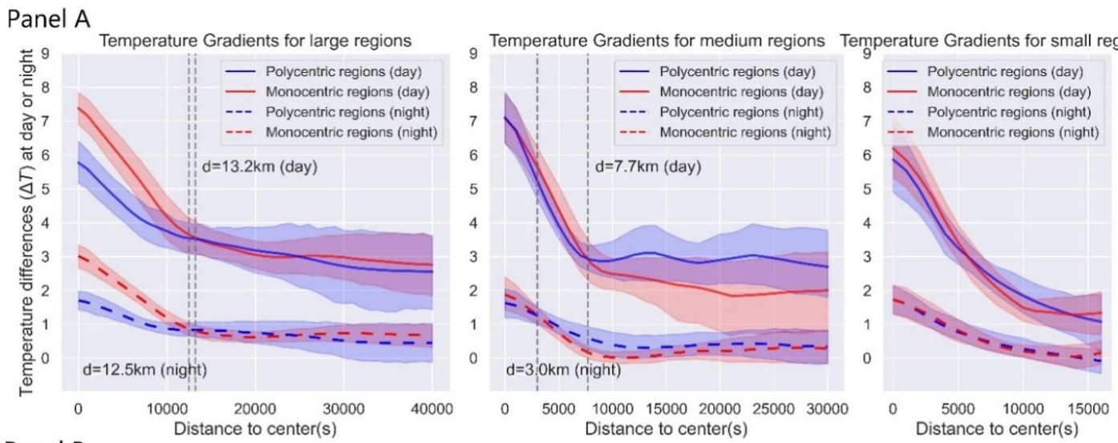
The influence of polycentric development on the UHI effect
Polycentricism: ↑ polycentricity, ↓ UHI effect for large-sized regions.
Mitigation effect:
most pronounced closer to the urban center(s);
gradually diminishes as the distance from CBDs.
Figure 3, Panel A: day- and night-time temperature gradients in large-, medium-, and small-sized regions estimated by local weighted regression.

Slide 16
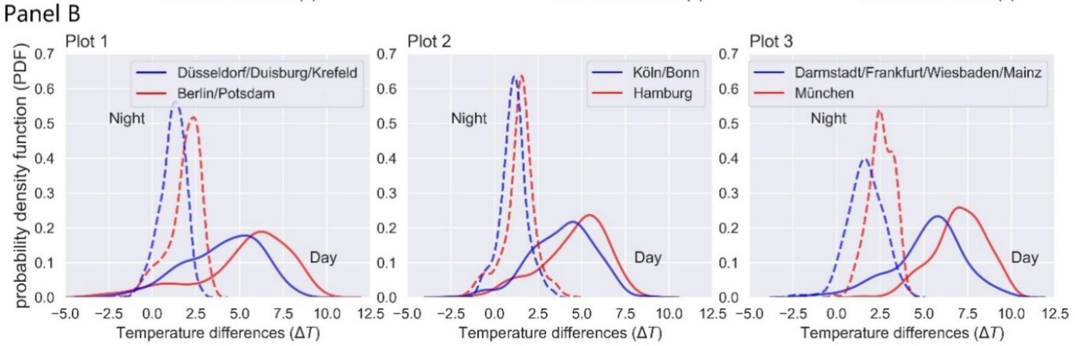
The influence of polycentric development on the UHI effect
Three selected pairs of regions
kernel density estimates
Monocentric regions: higher peak values shifted towards the right
a greater proportion of high-temperature areas
Panel B: day- and night-time kernel density estimates (KDE) for three representative region pairs using Gaussian kernel. Red depicts monocentric regions and blue polycentric regions.
Notes:
maximize their differences in the degree of polycentricity while maintaining the highest similarity in other attributes influencing urban heat. for each pair, a representative monocentric region (red) is selected and matched with its polycentric counterpart (blue) based on a Euclidean distance method that maximize the similarity of population density, urbanized area, windspeed, and precipitation between the two regions.

Slide 17
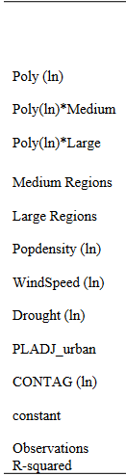
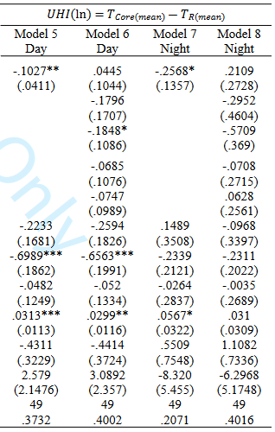
The influence of polycentric development on the UHI effect
Models 5 and 6: ↑ polycentricity,↓ UHI
Notes:
This substitution allows a more precise representation of heat intensity in the densely populated areas, as the urban core(s) specifically delineate the urban domain of regional central cities.

Slide 18
The influence of polycentric development on the UHI effect
Models 5 and 6: ↑ polycentricity,↓ UHI
Model 6: interaction term
Polycentricism is more effective in mitigating UHI effect of larger regions
Notes:
This substitution allows a more precise representation of heat intensity in the densely populated areas, as the urban core(s) specifically delineate the urban domain of regional central cities.

Slide 19
Conclusion and policy implication
Local land-use policy:
Facilitate more mixed land-use, more regularly-shaped urban spatial pattern
Local greenspace planning:
Several small better than a single large
More dispersed distribution of greenspace: reduce urban aggregation, decrease the overall density of urban cores
Regional scale planning:
Facilitate the development of polycentric urban regions (PURs)
particularly advantageous in cooling large-sized regions and CBD(s)
reduce density of urban core(s);
facilities disaggregated urban development;
curb excessive expansion of impervious surface.
Notes:
This study:
examines the effectiveness of urban spatial patterns in alleviating the UHI effect in Germany city regions (Großstadtregionen)
Use five landscape metrics and a polycentricity index to quantify urban spatial patterns.

Slide 20
Thank you!
Comments and Suggestions
Wenzheng Li, wl563@cornell.edu
Stephan Schmidt, sjs96@cornell.edu

Slide 21
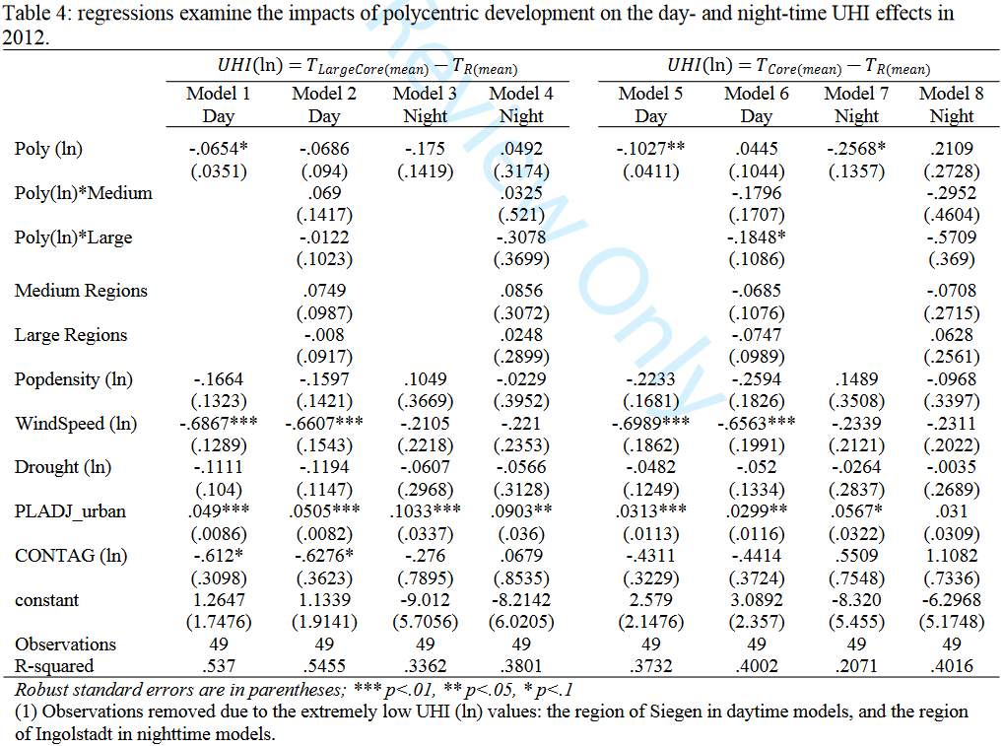
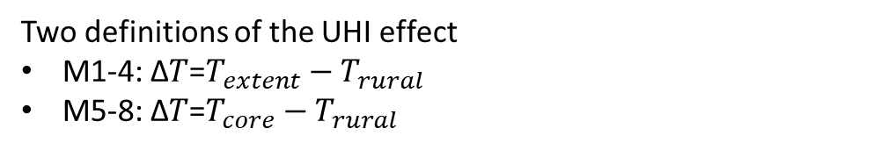
The influence of polycentric development on the UHI effect
Two definitions of the UHI effect
M1-4: Δ𝑇=$T_{extent}−T_{rural}$
M5-8: Δ𝑇=$T_{core}−T_{rural}$
M1-4
statistical significance in Model 1
interaction terms insignificant
Notes:
This substitution allows a more precise representation of heat intensity in the densely populated areas, as the urban core(s) specifically delineate the urban domain of regional central cities.

Slide 22
The influence of polycentric development on the UHI effect
Two definitions of the UHI effect
M1-4: Δ𝑇=$T_{extent}−T_{rural}$
M5-8: Δ𝑇=$T_{core}−T_{rural}$
M1-4
statistical significance in Model 1
interaction terms insignificant
M5-8
M5, M6: significant
↓ UHI within the urban core(s) rather than the extended large core area.
Notes:
This substitution allows a more precise representation of heat intensity in the densely populated areas, as the urban core(s) specifically delineate the urban domain of regional central cities.

Slide 23
The influence of polycentric development on the UHI effect
Two definitions of the UHI effect
M1-4: Δ𝑇=$T_{extent}−T_{rural}$
M5-8: Δ𝑇=$T_{core}−T_{rural}$
M1-4
statistical significance in Model 1
interaction terms insignificant
M5-8
M5, M6: significant
↓ UHI within the urban core(s) rather than the extended large core area.
M7: interaction term significant
Polycentricism is more effective in mitigating UHI effect of larger regions
Notes:
This substitution allows a more precise representation of heat intensity in the densely populated areas, as the urban core(s) specifically delineate the urban domain of regional central cities.

Slide 24
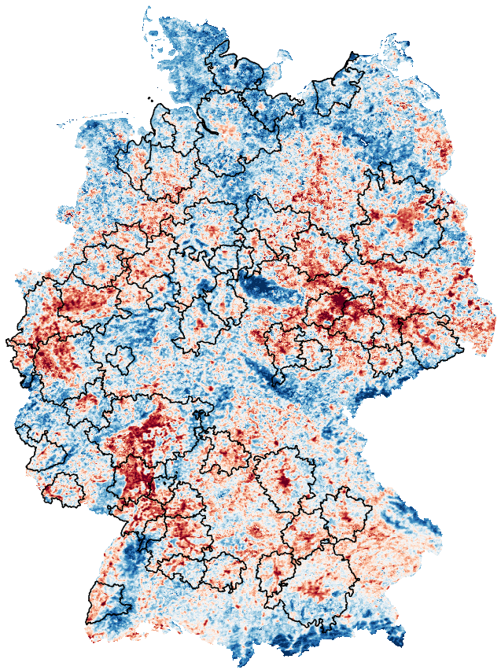
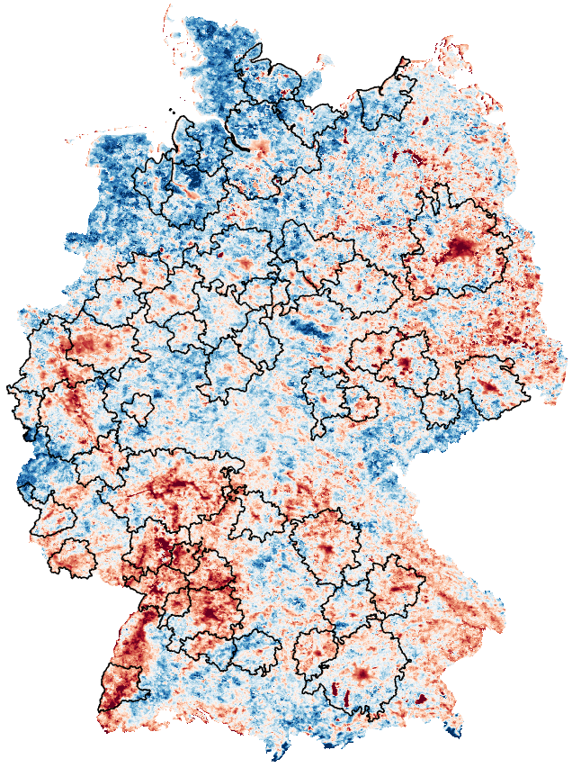
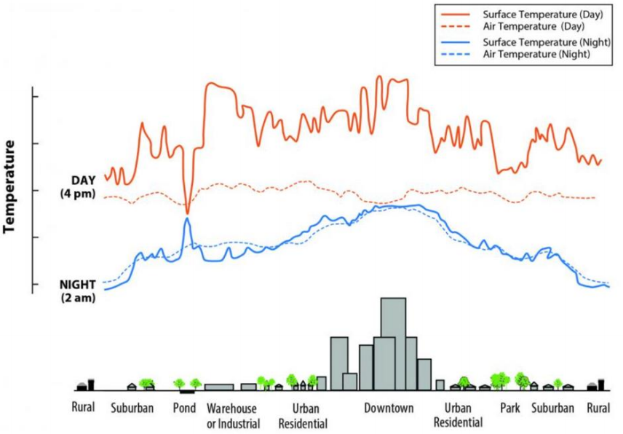
Land surface temperature (LST)
Mean land surface temperature (LST) in June, July, August :
MYD11A2.061 Aqua Land Surface Temperature and Emissivity 8-Day Global 1km.
Available at 1:30 PM (day) and 1:30AM (night)
LST Night - 1:30 AM
LST Day - 1:30 PM
Credit: U.S. Environmental Protection Agency
Notes:
We choose the MODIS 8-day LST product to calculate the mean LST in summer season for the entire Germany, as the UHI effects are most pronounced during this period. We choose to study both daytime 1:30pm and nighttime 1:30am LST because the temperature patterns at day and nighttime are different for the same landuse types,

Slide 25
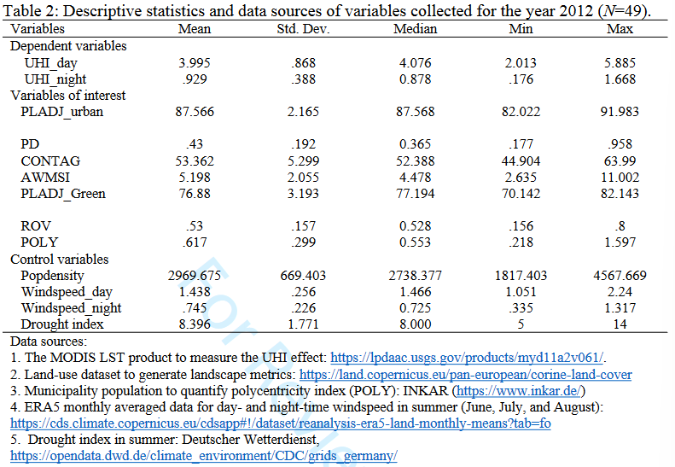
Notes:
We choose the MODIS 8-day LST product to calculate the mean LST in summer season for the entire Germany, as the UHI effects are most pronounced during this period. We choose to study both daytime 1:30pm and nighttime 1:30am LST because the temperature patterns at day and nighttime are different for the same landuse types,

Slide 26
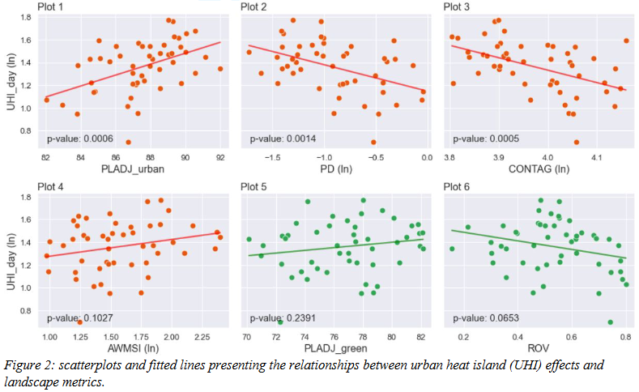
The influence of landscape metrics on the UHI effect

Slide 27
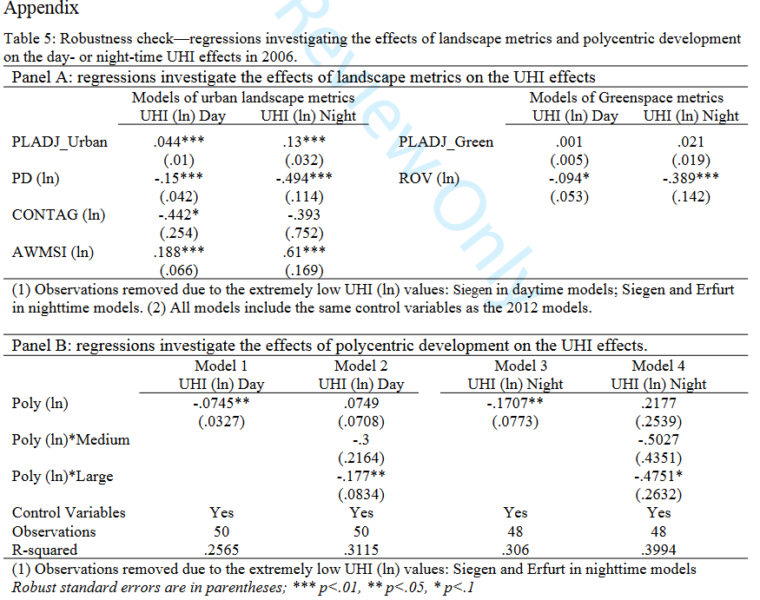

Slide 28
Polycentric spatial development and policy
European planning institutions began to promote regional polycentrism in the early 2000s to compete with global cities in North America and Asia (Faludi, 2005).
The 1999 European Spatial Development Perspective (ESDP):
guidance for “sectoral policies with significant spatial impacts”
linked polycentric urban forms, economic competitiveness, and deconcentrating economic growth (Commission of the European Communities, 1999: 11).
A wave of Euro-centric research on polycentricity followed,
the connection between polycentric urban form and desirable social, environmental, and economic outcomes (see, among many others, Aguilera, 2005; Kloosterman and Lambregts, 2001; Lambregts, 2009; Meijers and Sandberg, 2006; Meijers 2008; Hall and Pain 2006).

Slide 29
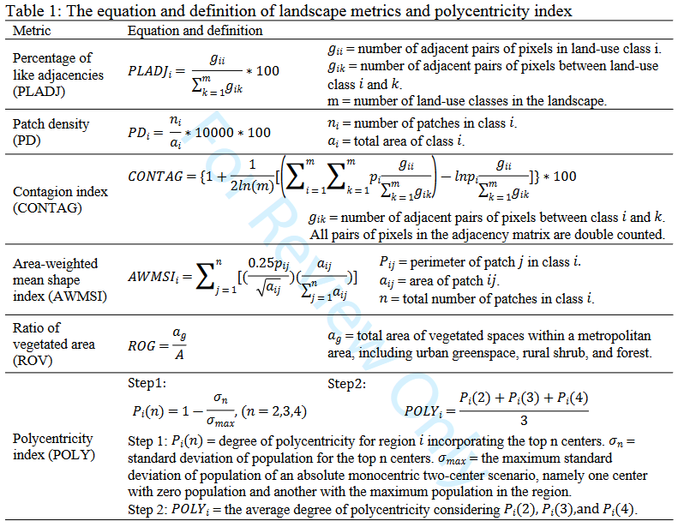
Spatial (landscape) metrics for urban spatial patterns

